Slide 1

08120: Programming 2: SoftwareTesting and Debugging
Dr Mike Brayshaw

Slide 2
Software Testing
    We study it because we want to get better at it and write better programs
    Software Development Organisations can spend up to 40% of time testing
    In critical domains (e.g. flight control, nuclear reactor) costs can be 3 to 5 times costs of all other steps added together
      It is expensive
      We need to get it right

Slide 3
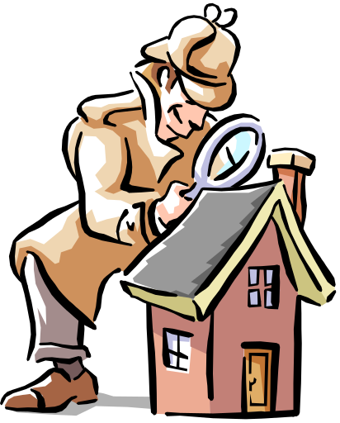
Do we always need to test?
    some people claim no
      use of formal methods
      use of rigorous engineering
      use of high level paradigm
      program == specification
    Yes we do
    - there may be unseen errors (e.g. in spec)
    - the software may evolve, the world may change, the software may change (new platform or compiler)
to err is human, programmers make mistakes, even good ones!!!

Slide 4
Objectives of Testing
Is it always a destructive process - are you just trying to break a system?
What are trying to find problems and Errors
To do so we need to think what are good test cases
      - a good test case is something that “has a high probability of finding a yet undiscovered error” (Somerville, pp. 610)
A successful tests is one that uncovers a hitherto undetected error

Slide 5

What will it reveal?
    If successful errors!
    It allows us to test the software against its specification
    We can check its performance
    Indirectly it gives insight into the reliability and quality of the software

Slide 6
So how do you go about testing 1
    First Approach
    Does it do the job?
      does it meet its functional requirements
      test each function that the software is designed to implement and see if its up for the job
this is called black box testing

Slide 7

So how do you go about testing 2
Second Approach
Does it work correctly internally?
      test how the innards work
      is it implemented as on the technical specification
      inspect the code itself
this is known as white box testing

Slide 8
A systematic approach to testing using White Box and Black Box
In Black Box testing we can take the functional requirements of the software and check these
In White Box testing or if we know the internal workings of the program we can take a close look at its procedural detail to check its working methods are correct
White box testing is very expensive and exhaustive testing is not possible for non-trivial problems
Use a combination of white and black box testing

Slide 9
White Box Testing
Check all independent paths thru the code
Check both sides of logical decisions like Booleans
Check all loop with normal values and at limits
Check internal data structures

Slide 10
Why go to such lengths?
Problems with workhorse code are likely to have been trapped and cured long ago, it’s the seldom used stuff that can still hide problems
We may have the wrong intuition about the logical path the program is taking. Stuff that we never expected to be executed could be doing so on a regular basis. Hence the need for path testing.
  this may also reveal efficiency issues
  unreachable code

Slide 11
Path Testing 1
We can find the number of different flow of control paths through the program
The upper bound - cyclomatic complexity metric - defines the number of independent paths thru a program
this also gives an upper bound on the number of tests we need to perform to garentee coverage of all program statements

Slide 12
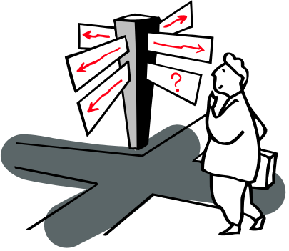
Path Testing 2
For a given program to test
Work out the flow of control for the program
Work out cyclomatic complexity
Work out a set of linear independent paths
Make test cases that will force the program to go down a particular route

Slide 13
Producing a Call Tree: Analysing your program structure
Starting with the first procedure (often called main in some languages) draw the calling structure
Will show structure of the program
Easy to automate (Standard utility in many systems)
Finds unused code
In OOP can show hierarchy of objects
    show what inherits what from where
    allows development of browsers (e.g. BlueJ)

Slide 14

Condition and Loop Testing
Can use our existing path detection algorithm to exhaustively white box test conditions
For loops we can check for bounds, upper and lower limit. This can be thought of stress testing your loops
Instrumenting Your Code

Slide 15
Black Box Testing
Does the software meet is functional requirements?
Check its input or output is correct
Is the system sensitive to different types of data
What rates and volumes can the system handle
Does it handle boundaries ok?
This can be done by software testers who just continually use and re-use the software to make sure it is correct

Slide 16
Development of a Test suit
Test all the functional requirements of the software
Pushes it through all the moves that you want the program to make
Can make an output file that can be compared to previous run throughs so you know you code is correct

Slide 17
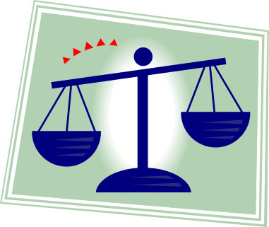
Comparison Testing
When we need to be sure
Two (or more) software teams
Same requirements, write two independant programs and compare the behaviour of the two
If the work in the same manner then this is a check the all is well
In extreme make teams use different language, platforms, or to be really sure different paradigms (e.g. a logic language like Prolog)

